Slide 1
COMPUTER GRAPHICS & MULTIMEDIA
UNIT-2
-by Sakshi Jha

Slide 2
SYLLABUS
Clipping Algorithms: Sutherland-Cohen line Clipping Algorithm,
Bezier Curves,
B-Spline Curves.
Parallel projection,
Perspective Projection,
Illumination Model for diffused Reflection,
Ambient light,
Specular Reflection Model,
Reflection Vector.

Slide 3
PARALLEL PROJECTION

Slide 4
A parallel projection (or axonometric projection) is a projection of an object in three-dimensional space onto a fixed plane, known as the projection plane or image plane, where the rays, known as lines of sight or projection lines, are parallel to each other.
Parallel projection discards z-coordinate and parallel lines from each vertex on the object are extended until they intersect the view plane.
In parallel projection, we specify a direction of projection instead of center of projection.
In parallel projection, the distance from the center of projection to project plane is infinite.
In this type of projection, we connect the projected vertices by line segments which correspond to connections on the original object.
Parallel projections are less realistic, but they are good for exact measurements.
In this type of projections, parallel lines remain parallel and angles are not preserved.

Slide 5
TYPES OF PARALLEL PROJECTION
PARALLEL PROJECTION
ORTHOGRAPHIC PROJECTION
Axonometric Orthographic Projection
OBLIQUE PROJECTION
Cavalier Projection
Multiview Orthographic Projection
Cabinet Projection

Slide 6
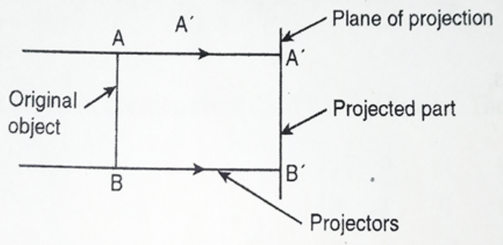
ORTHOGRAPHIC PROJECTION
It occurs when the direction of projection is perpendicular in which the direction of projection isn’t parallel to any of the three principal axes.

Slide 7
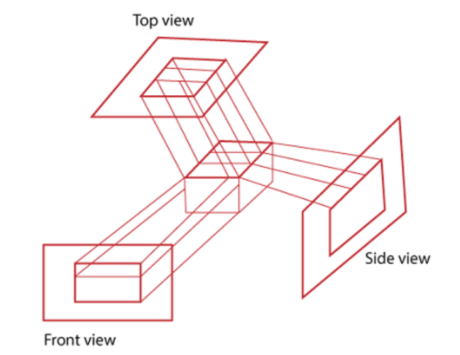
Multiview Orthographic Projection
In Multiview Orthographic Projection, we can represent the two-dimensional Orthographic image into a three-dimensional object. The Multiview Orthographic Projection Includes-
Front View
Top View
Side View

Slide 8
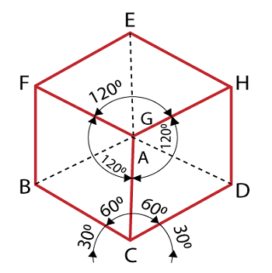
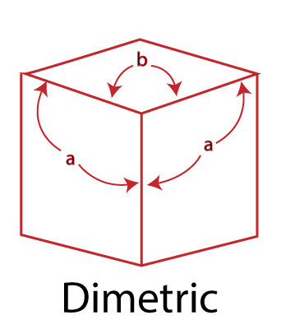
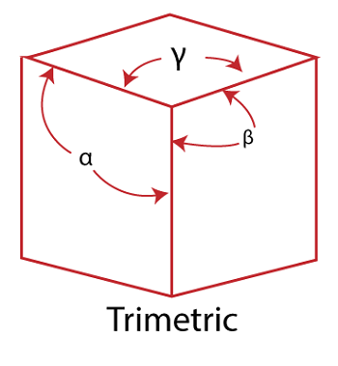
Axonometric Orthographic Projection
The Axonometric Orthographic Projection is used to construct the pictorial representation of an object. The sight lines are perpendicular to the projection plane.
1. Isometric: In Isometric, we can represent the three-dimensional objects into two-dimensional drawings visually. The Angle between the two co-ordinate is 120 degrees.
2. Dimetric: In Dimetric Projection, the view direction of the two axes are equal, and the direction of the third axis is defined individually.
3. Trimetric: In the Trimetric Projection, the view direction of all three axes is unequal. The scale of all three angles is defined individually.
Isometric

Slide 9
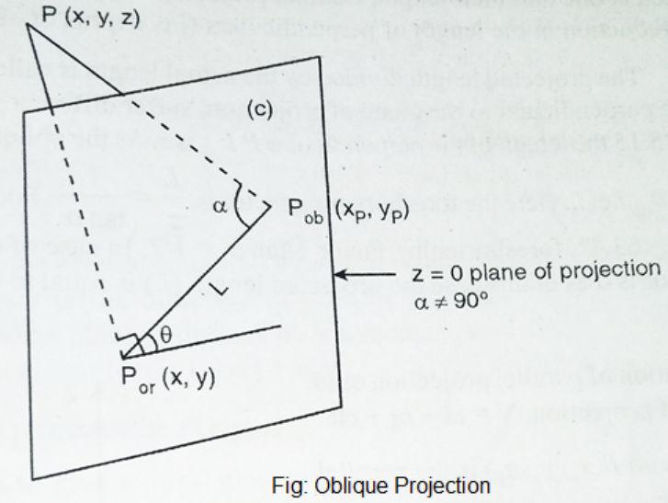
OBLIQUE PROJECTION
When the angle between the projectors and the plane of projection isn’t equal to 90 then the projection says oblique projection.

Slide 10
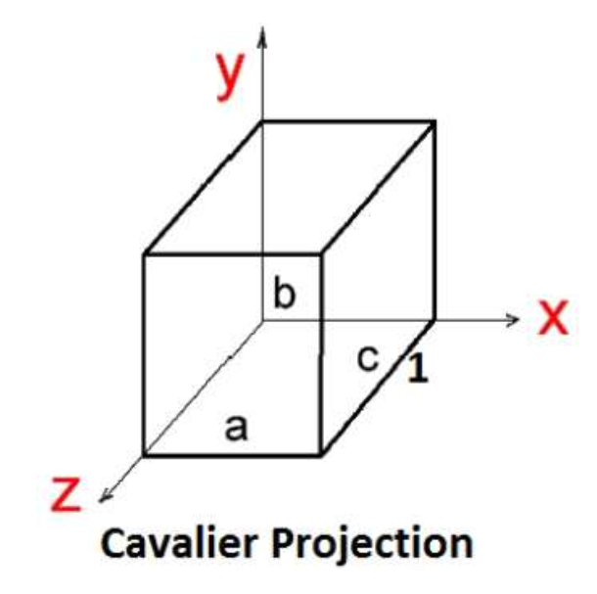
CAVALIER PROJECTION
The Cavalier projection makes 45° angle with the projection plane. The projection of a line perpendicular to the view plane has the same length as the line itself in Cavalier projection.
In a cavalier projection, the foreshortening factors for all three principal directions are equal.

Slide 11
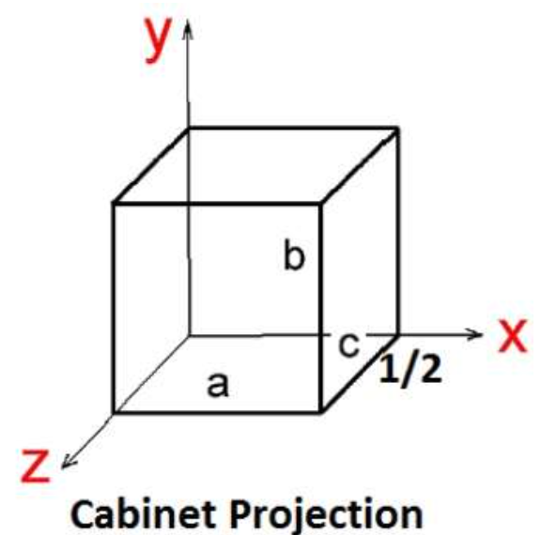
CABINET PROJECTION
The Cabinet projection makes 63.4° angle with the projection plane. In Cabinet projection, lines perpendicular to the viewing surface are projected at ½ their actual length.

Slide 12
PERSPECTIVE PROJECTION

Slide 13
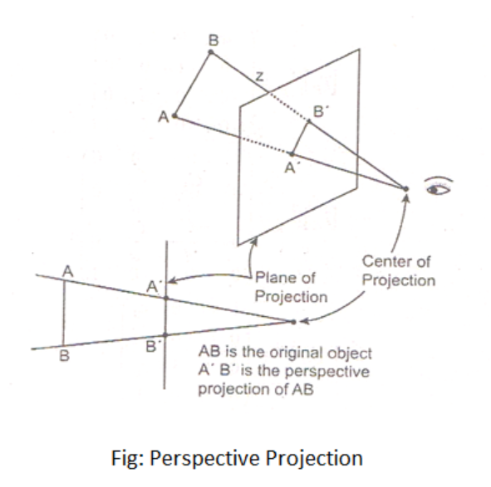
In the perspective projection, the distance of the project plane from the center of projection is finite.
The size of the object varies inversely with distance which looks more realistic.
Perspective projection is used to determine the projector lines come together at a single point. The single point is also called “project reference point” or “Center of projection.”
The distance and angles are not preserved and parallel lines do not remain parallel.

Slide 14
Characteristics of Perspective Projection
The Distance between the object and projection center is finite.
In Perspective Projection, it is difficult to define the actual size and shape of the object.
The Perspective Projection has the concept of vanishing points.
The Perspective Projection is realistic but tough to implement.
Vanishing Point: Vanishing point can be defined as a point in image plane where all parallel lines are interlinked. The Vanishing point is also called “Directing Point.”
Use of Vanishing Point:
It is used in 3D games and graphics editing.
It is also used to represent 3D objects.
We can also include perspective in the background of an image.
We can also insert the shadow effect in an image.

Slide 15
Types Of Perspective Projections
There are 3 types of perspective projections.
1.One point perspective projection : A One Point perspective contains only one vanishing point on the horizon line. It is easy to draw.
Use of One Point– The One Point projection is mostly used to draw the images of roads, railway tracks, and buildings.
2.Two point perspective projection gives better impression of depth. It is also called “Angular Perspective.” A Two Point perspective contains two vanishing points on the line.
Use of Two Point– The main use of Two Point projection is to draw the two corner roads.
3. Three-Point perspective projection – The Three-Point Perspective contains three vanishing points. Two points lie on the horizon line, and one above or below the line.It is very difficult to draw. When we see an object from above, than the third point is below the ground. If we see an object from the below, than the third point is in the space above.
Use of Three-Point: It is mainly used in skyscraping.

Slide 16
